Slide 1
Bitcoin, the Gold Mine for GIS
How the fundamental computer science concepts behind emerging technologies like cryptocurrencies can be applied to improved geospatial data security, integrity, and sharing.
Joshua Tanner
State of Oregon
Geospatial Enterprise Office

Slide 2
Goals
Understand key terms
How it relates to GIS
Get people talking

Slide 3
A Very Very Basic Explanation of Cryptocurrencies

Slide 4
Blockchain
Public append only ledger
Add data, can’t change previous data
Create consensus among others (distributed)
Relies on challenge to add ‘block’, hard to solve, easy to verify
Notes:
Bitcoin is a cryptocurrency. They are other cryptocurrencies. Underlying concept is blockchain.
• Public append only ledger • Add data to, can't change previous data within it • Creates consensus among decentralized parties, don't have to trust each other, but need to trust mechanism by which their consensus is arrived at • Relies on some form of challenge, such that no 1 actor on the network can solve challenge easily • Verify transactions in such a way that is impossible to defraud or alter after the fact

Slide 5
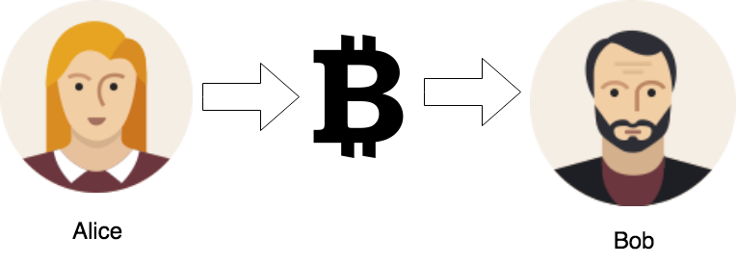
Notes:
Alice wants to send money to Bob.

Slide 6
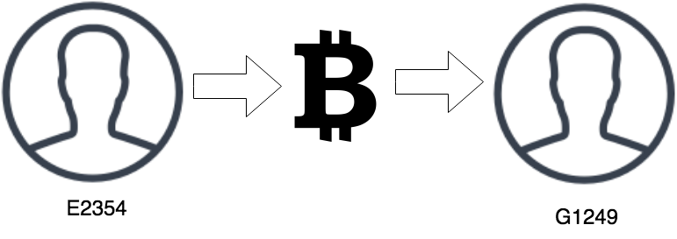
Notes:
Alice and Bob aren’t unique and we also don’t want their names exposed. So, we will address them by their public ID, which is unique to them. We can think of this much like a SSN.

Slide 7
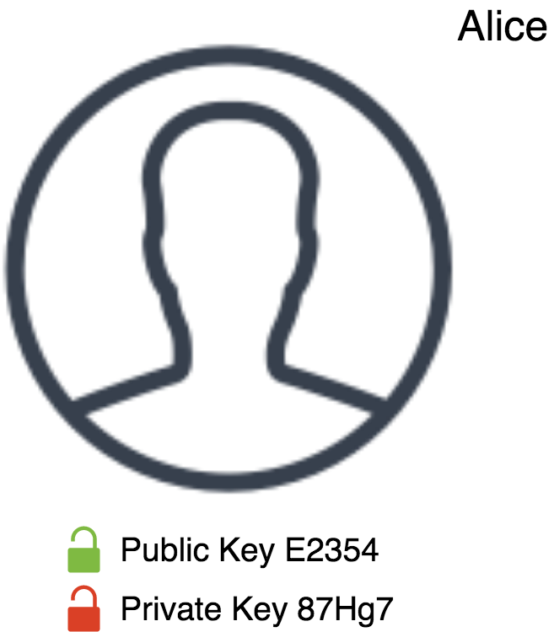
Notes:
E2354, formerly known as Alice, is now addressed by her public key. She also has a private key that she never shares with anyone. This is used to append a signature to any transactions she makes.

Slide 8
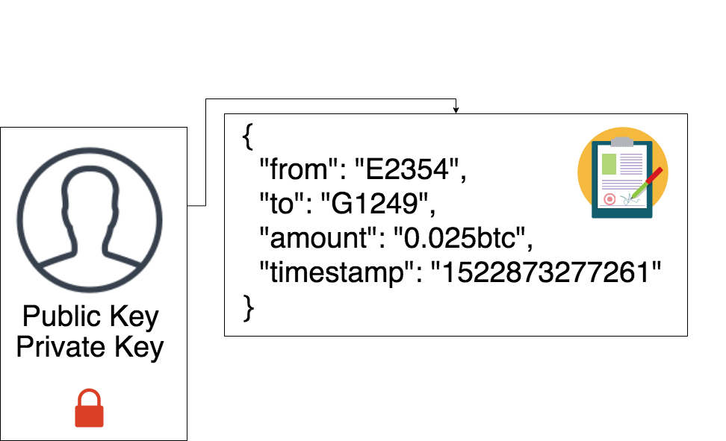
Notes:
Here is an example of a transaction. Since Alice signed it using public / private key encryption, others can easily verify (using the public key, message, and signature), that the transaction was indeed created using Alice’s private key, without actually exposing the private key.

Slide 9
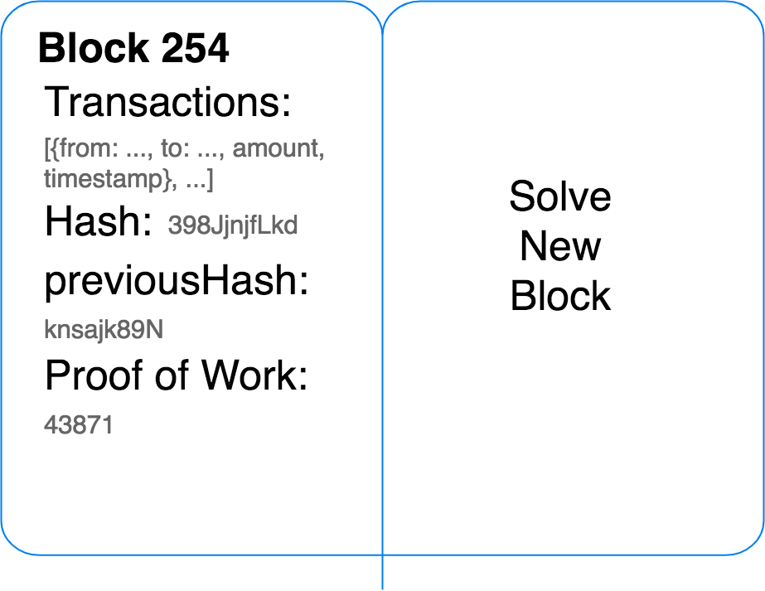
Notes:
Emphasize not being able to alter previous transactions. The ‘chain’.
The goal is now to verify some transactions and add them to our public ledger, known as the blockchain. Each ‘block’ is like a page in a ledger. It contains an array of transactions, the root hash of those transactions, and the previous hash. This reference to the previous hash is what makes this a ‘chain’. Finally a proof of work is the solution to a problem that had to be solved in order for this block to be added to the chain.
If any transaction is altered, the whole chain now fails when you try to verify it.

Slide 10
Notes:
Once a ‘miner’ has verified a set of transactions and solved a very difficult mathematical problem, a new block can be added to the chain. The problem that was difficult to solve is actually very simple to verify. Other users can sync the new block, identifying changes with a Merkle Tree, and easily verify that it is indeed valid. Users don’t need to trust each other, only the math and mechanisms by which their consensus is arrived at. Instead of our traditional centralized or decentralized architectures, we now have a truly distributed system in which each user has a complete copy of the blockchain and can sync with each other.

Slide 11
Terms
Cryptographic Hash
Merkle Tree
Root Hash
Distributed Network
Public / Private Key Encryption
Proof of Work
Notes:
Who is familiar with some of these terms? All of these terms? Think they can be applied to GIS?

Slide 12
Cryptographic
Hash

Slide 13

Infinite
Fixed
Notes:
A hash function takes an input of arbitrary size, and returns a value that is fixed in size that is entirely unique. By unique, I mean that no other combination of input (very high collision resistance) would create the same output value.

Slide 14
Hashing Algorithms
Blake, MD5, SHA-256
Notes:
Here you can see that by passing a string to a hashing algorithm, we get completely different outputs, even if only one word is changed. Examples of popular hashing algorithms include Blake, MD5, and SHA-256.

Slide 15
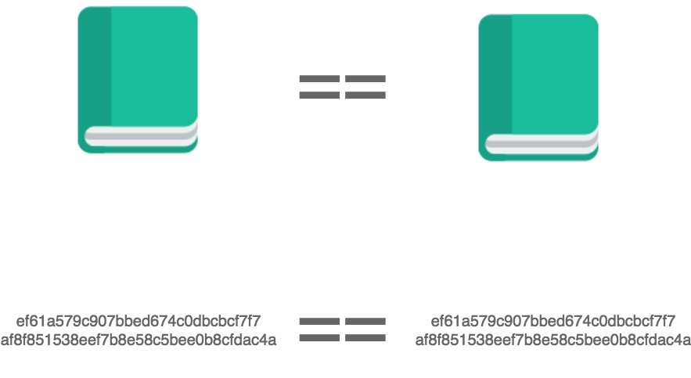
Notes:
This makes it easy to compare two inputs, again of arbitrary size. Take a book for example. Remove a single space, and the hash of that book will look completely different. Instead of comparing the entire book against another book, we just compare the 256 bit string against another 256 bit string. If they are the same, then we have the same book.

Slide 16
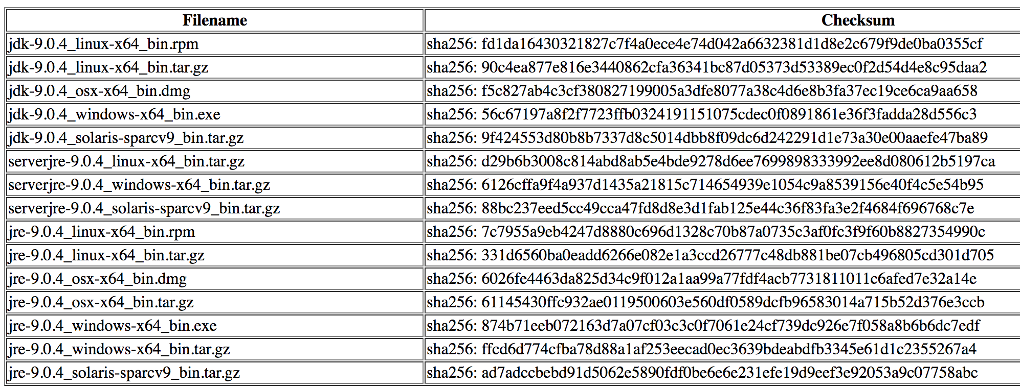
GIS 1: Checksum
Notes:
A checksum is a way to verify data integrity. It helps identify if there was an error in transmission when downloading a dataset. Comparing hashes can also help check if the file we are working with is indeed the latest.

Slide 17
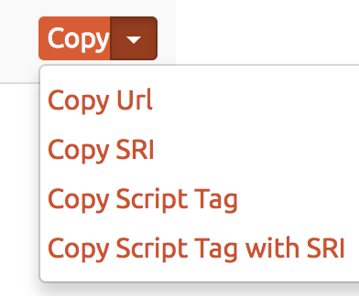
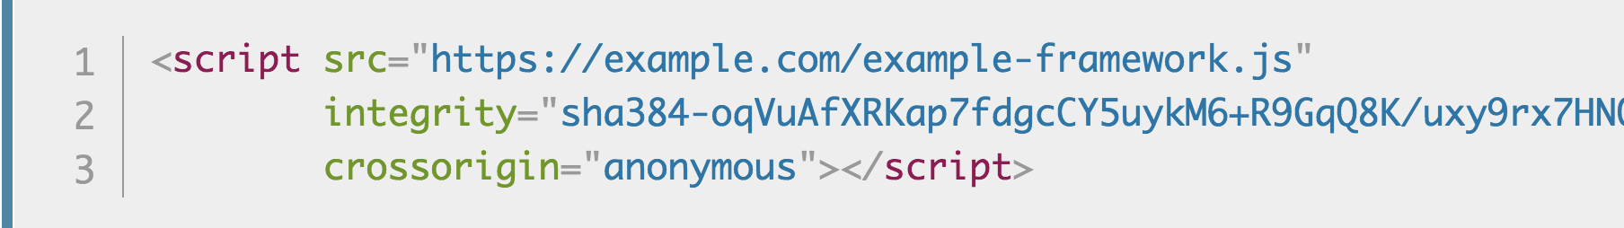
GIS 2: Subresource Integrity
Notes:
Do you ever reference external CDN scripts or remote GeoJSON datasets? GIS apps should consider using Subresource Integrity in their script or link tags. Your browser compares hash of script against value given in integrity attribute. If an attacker gained control of an external host, our web app would reject the potentially malicious code or data if it didn’t match our known and trusted sha384 hash.

Slide 18
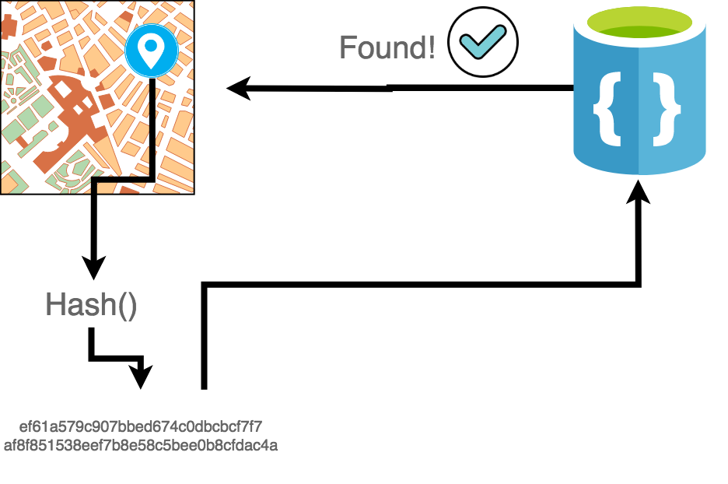
GIS 3: Unique Feature Signatures
Authoritative
EXAMPLE
Notes:
Imagine you are working in OpenStreetMap and do an extract of building footprint data. Some of those footprints were contributed by an authoritative source, like Metro. Some were not. Comparing against a known hash table of authoritative data, we could send the hash of our OpenStreetMap building footprint to see if it is a known authoritative feature. There are two benefits of using hashes:
You are sending a fixed length value. If network latency is an issue, you want to send as little as you can over the wire. Geometries can get large and potentially too large to be usable for comparison over the network.
Since hashes are unique, they can be stored in a JSON like hash table, having constant time lookup speeds.

Slide 20
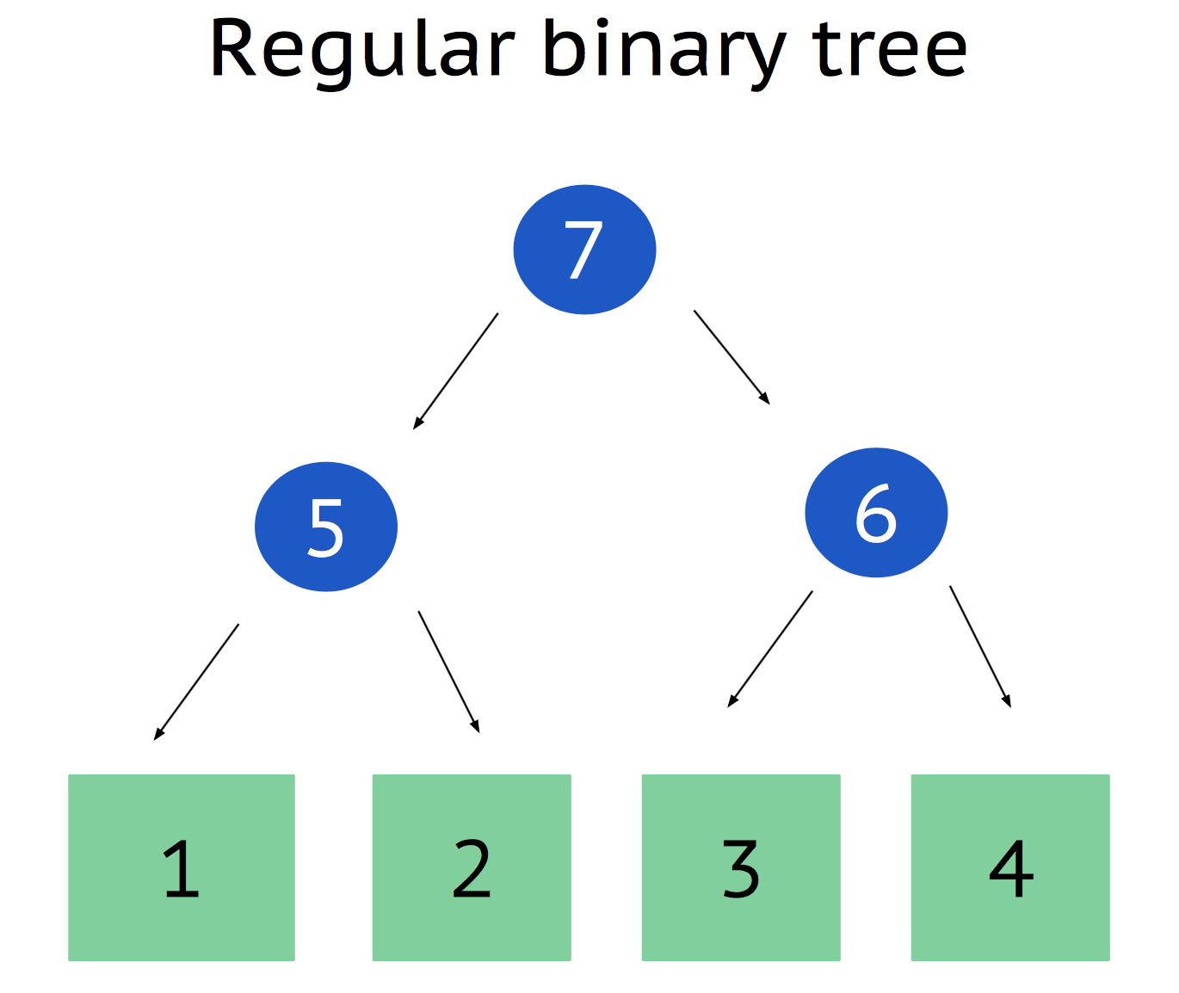
Merkle Tree &
Root Hash
Notes:
Merkle trees are how you verify and sync data amongst a network of peers.

Slide 21
Notes:
A tree is good for data with an inherent hierarchy. This data structure can help us search for and sort data efficiently. Take for example a family tree. Instead of just having a list of every family member, we can start to split the tree into branches that make it easy to find a particular member of your extended family.

Slide 22
Notes:
We see this in geospatial indexing, like the R-Tree.

Slide 23
Notes:
Merkle Trees are regular binary trees (each node has at least two children).

Slide 24
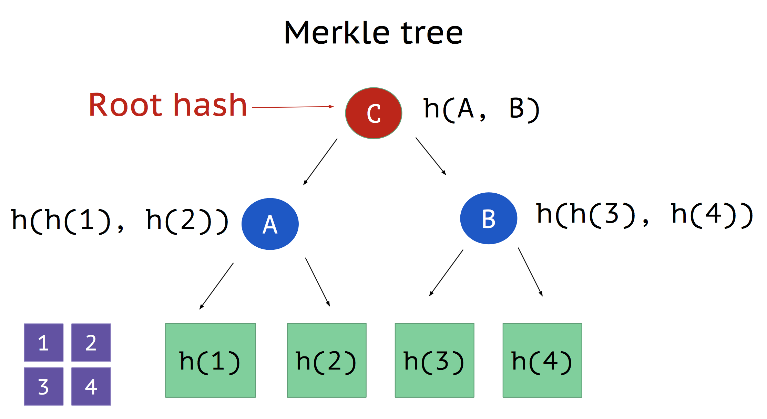
Notes:
Nodes store hashes, instead of chunks of data. Leaf nodes, hashes of chunks of data. Parent nodes result of concatenating hashes and then hashing that value. Do this until get to beginning node, called the root hash.

Slide 25
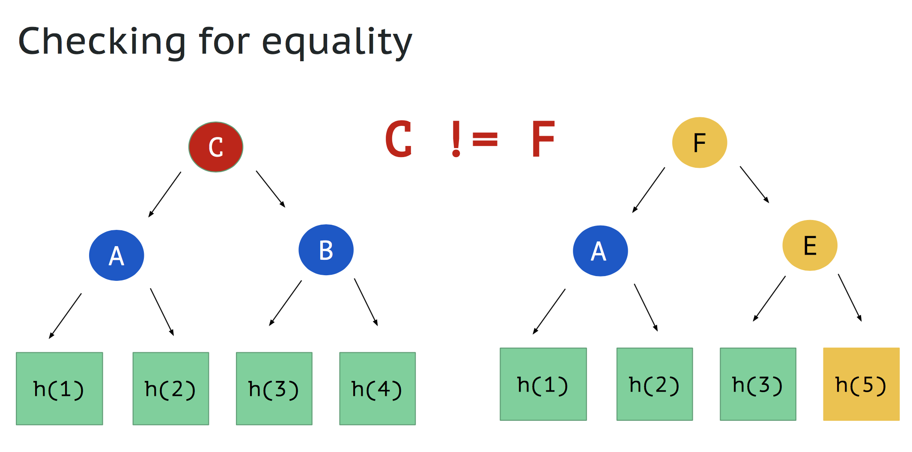

Slide 26
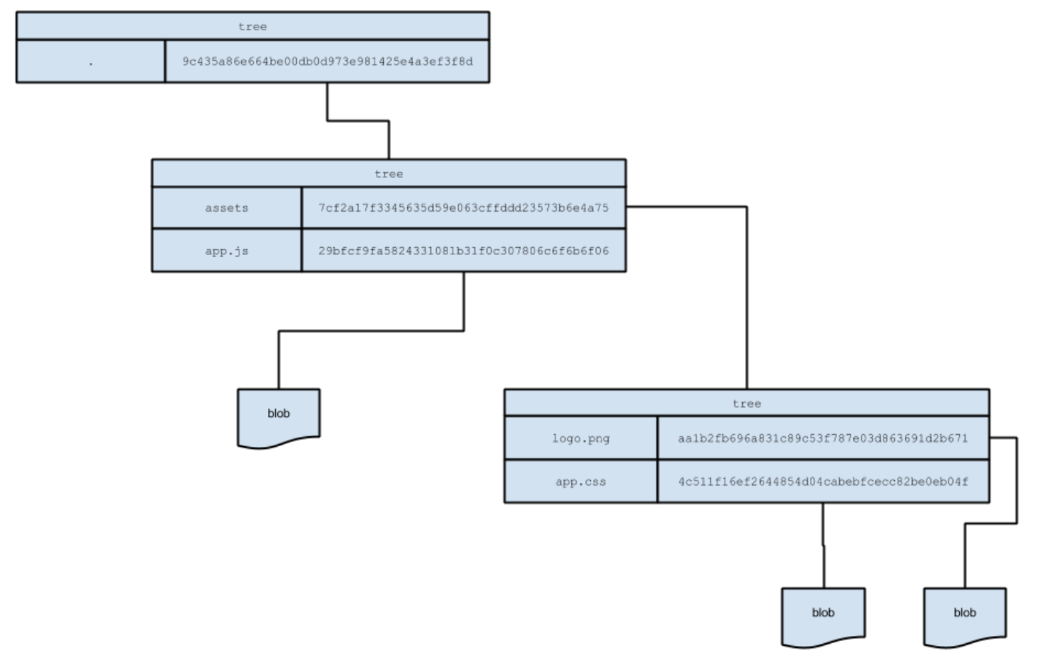
Notes:
If you’re familiar with Git, you might have noticed that files are referenced by their hash at the time. Change any line of code and you get a new hash. This is how you determine if your local files are different than what is in your remote git repository.

Slide 27
GIS 1: Syncing Updates
Notes:
In the example of checking for equality, we can first check if the root hashes match between a local copy of data another source. If they match, we know we have the latest data source. Next, we can start comparing nodes and determine only the pieces that we need instead of downloading the entire dataset again.

Slide 28
GIS 2: Rabin Fingerprinting
Notes:
Content defined chunking as opposed to fixed length chunking. Good for syncing binary files, like PDF’s, images, large spatial files, etc.

Slide 29
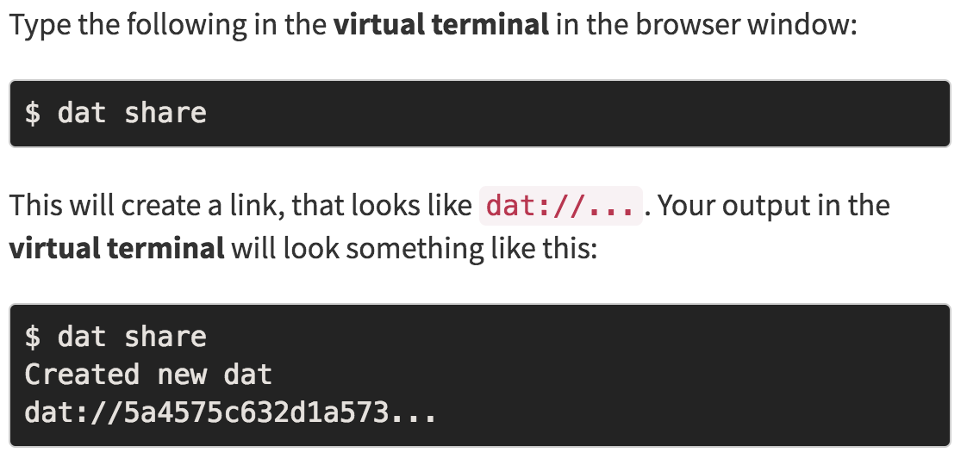
GIS 3: Referencing Specific Versions of Data
Notes:
Root hash is unique address to your content. If anything changes, the root hash will be completely different.

Slide 30
Distributed System

Slide 31
Notes:
Don’t have to trust peers in a distributed network, just need to be able to verify mechanism by which consensus is arrived at.

Slide 32
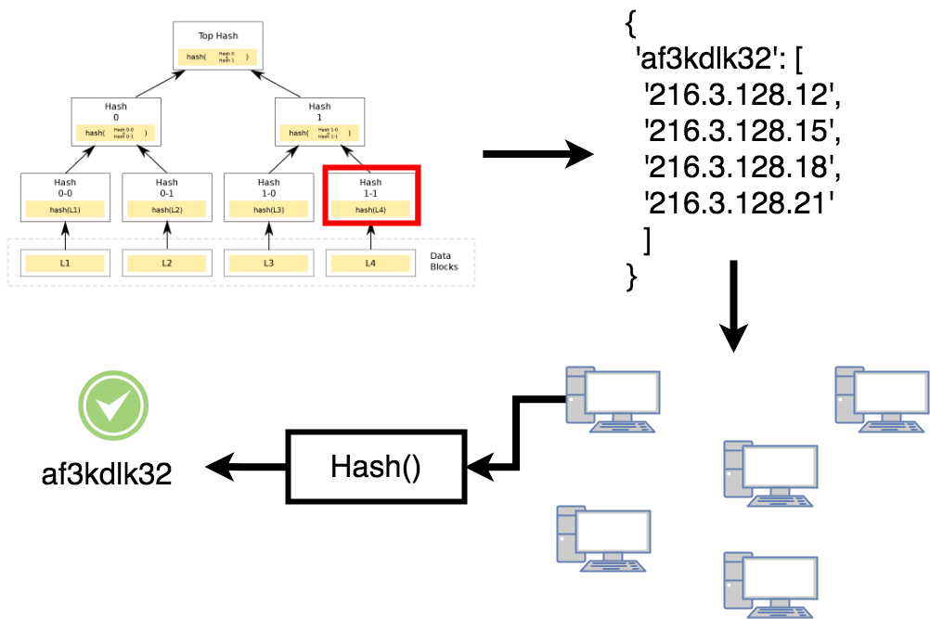
Untrusted Peers

Slide 33
Public / Private
Key Encryption

Slide 34
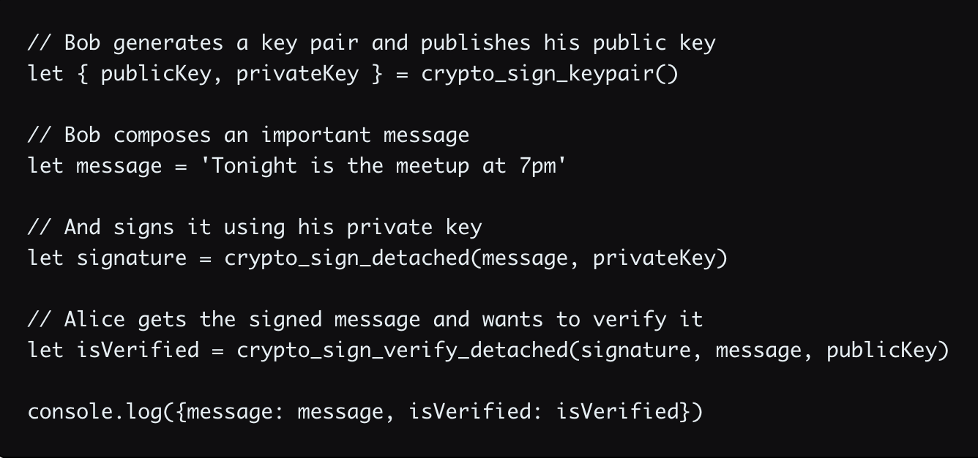
• Bob wants to send a message to Alice
• He wants Alice to know it came from him
• The message contents can be read by others
• Bob gives away copies of his seal and signature
• Bob signs and seals messages before sending to Alice

Slide 35
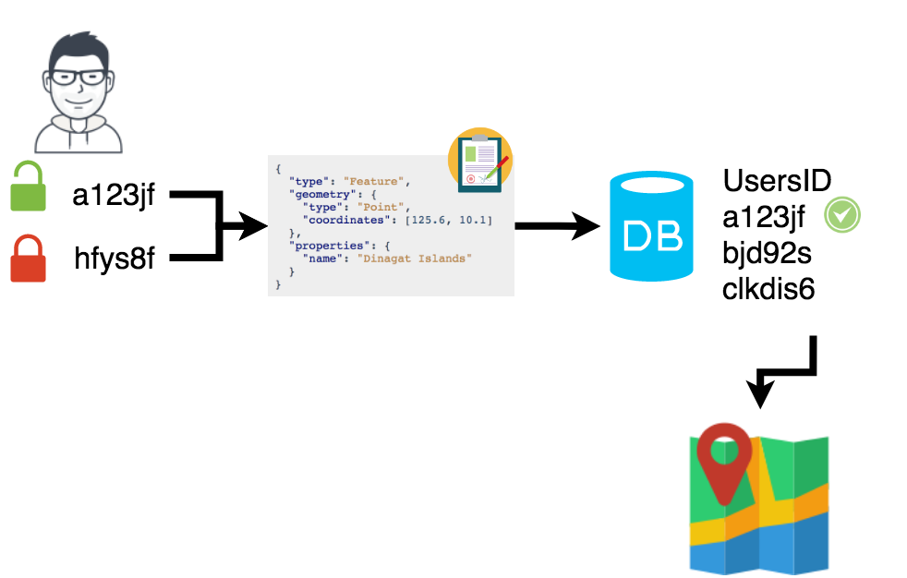
GIS 1: Secure Updates / Edits

Slide 36
Proof of Work

Slide 37
Notes:
Proof of work. Expensive to perform, but cheap to verify. Bitcoin uses hashcash. Bitcoin currently uses 17 0’s

Slide 38
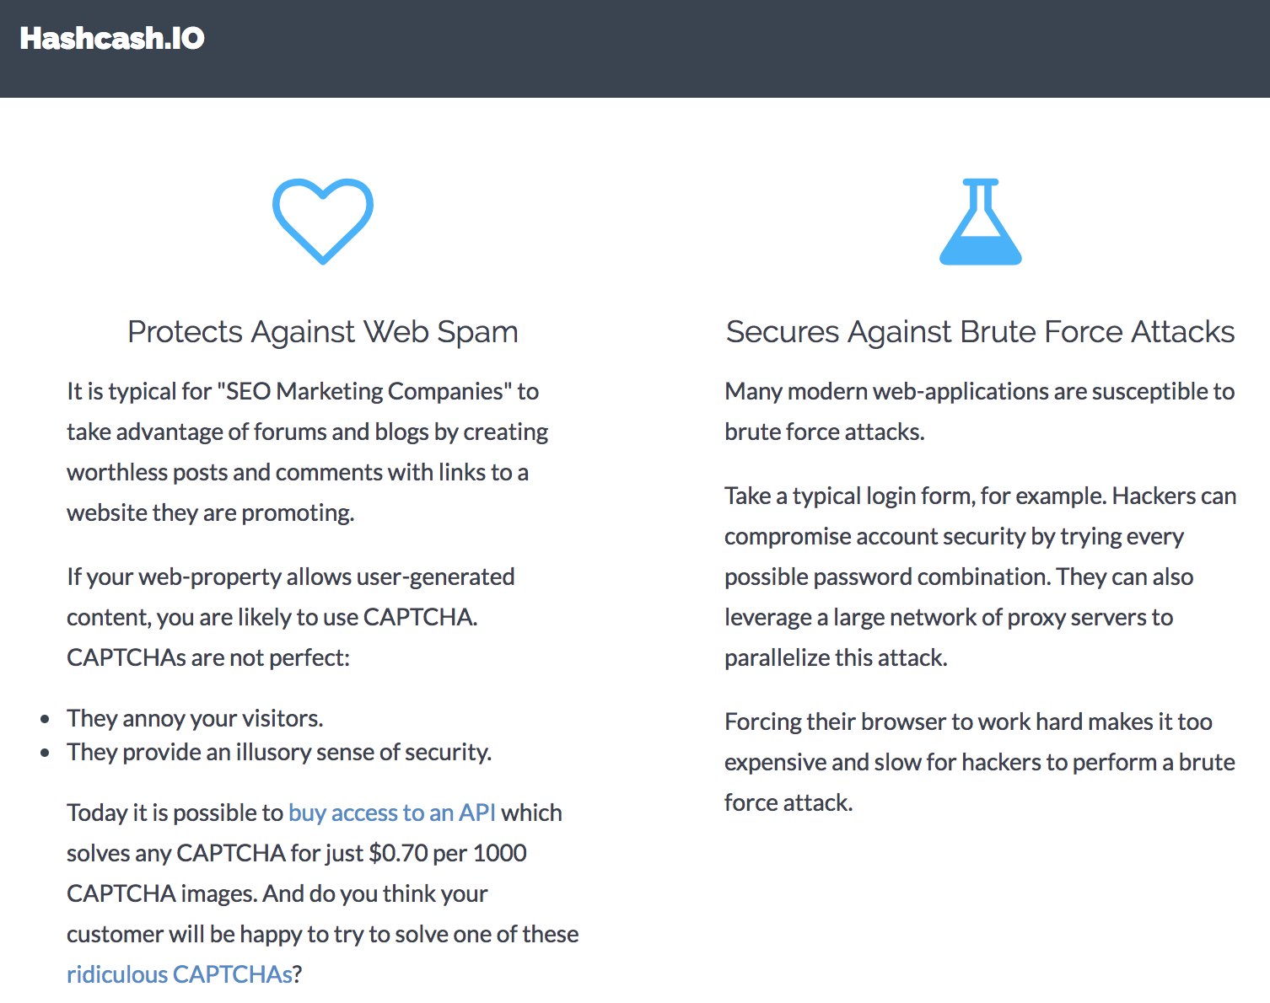

Slide 39
Applications in GIS
Throttle server requests (DDoS attacks)
Comment forms for user input
Brute force password requests
Reducing SPAM email!!

Slide 40
DAT Whitepaper
Rabin Fingerprinting
Merkle Trees Explained
Blockchain Explained in 5 Levels of Difficulty
Khan Academy - Bitcoin
A Dive Into Spatial Search Algorithms
An Intro to DAT’s Cryptography
GitHub Example - Hashing Spatial Features
Beaker Browser (Distributed Web Browser)

Slide 41
Questions?

